Slide 1


File operator

Slide 2

Overview
The Personal Journal Manager is a Python application designed to let users maintain a personal text journal. Built using Object-Oriented Programming (OOP) principles, it provides file operations such as appending new entries, reading stored text, searching for entries by keywords or dates, and deleting journal data.

Slide 3

Architecture & Class Structure
Class: JournalManager
Attributes:
filename (str): Stores the target file name for operations (defaults to "journal.txt").

Slide 4

Methods:
init__(self, filename="journal.txt"): Initializes the manager with a designated filename.
Add _ entry(self, user _ input): Appends timestamped text to the journal file using mode 'a'.
View _ all_ entries(self): Reads and prints all entries using mode 'r'.
Search _ entry(self, keyword): Case-insensitively searches entries separated by blank lines (\n\n).
Delete _all _ entries(self): Deletes the target file using os. remove() after user confirmation.

Slide 5
File Handling & Operations
Operation | Mode / Function | Implementation Details
Write/Append | Mode 'a' | Appends a timestamp ([YYYY-MM-DD HH:MM:SS]) followed by input text and standard separators. Creates the file automatically if it does not exist.
Read | Mode 'r' | Reads the entire content to display to the user or splits entries by \n\n for filtering.
Delete | os.remove() | Deletes the text file completely from the system disk upon confirmation

Slide 6
Exception Handling & Validation
The application includes try-except blocks to ensure program stability during run-time errors:
File Not Found Error Prevention: Checked prior to read, search, and delete operations using os. path. exists () to avoid abrupt crashes when the journal file is missing.
Permission Error: Trapped when reading, appending, or deleting files if operating system permissions restrict access.
Generic Exceptions: A general except Exception as e clause catches unhandled system exceptions to prevent script termination.
Menu Input Handling: Validates menu entries (1 through 5) and outputs specific error prompts for invalid menu inputs.

Slide 7
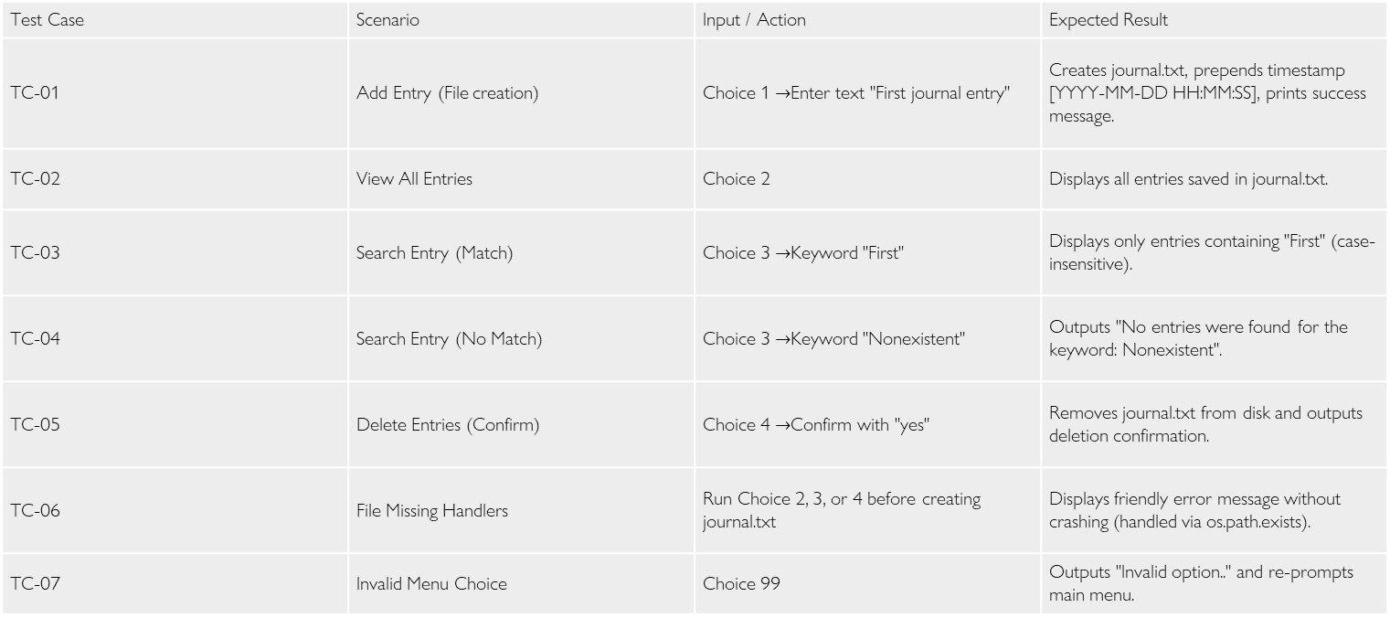
Functionality Test Cases
Test Case | Scenario | Input / Action | Expected Result
TC-01 | Add Entry (File creation) | Choice 1 $→$Enter text "First journal entry" | Creates journal.txt, prepends timestamp [YYYY-MM-DD HH:MM:SS], prints success message.
TC-02 | View All Entries | Choice 2 | Displays all entries saved in journal.txt.
TC-03 | Search Entry (Match) | Choice 3 $→$Keyword "First" | Displays only entries containing "First" (case-insensitive).
TC-04 | Search Entry (No Match) | Choice 3 $→$Keyword "Nonexistent" | Outputs "No entries were found for the keyword: Nonexistent".
TC-05 | Delete Entries (Confirm) | Choice 4 $→$Confirm with "yes" | Removes journal.txt from disk and outputs deletion confirmation.
TC-06 | File Missing Handlers | Run Choice 2, 3, or 4 before creating journal.txt | Displays friendly error message without crashing (handled via os.path.exists).
TC-07 | Invalid Menu Choice | Choice 99 | Outputs "Invalid option.." and re-prompts main menu.

Slide 8
Execution Walkthrough
saving the Script
Save your Python code in a file named project 6 rnw.py.
Running the Program
Open your terminal/command prompt and run:
Bash
python "project 6 rnw.py"

Slide 9
Sample Session Output
=== Welcome to Personal Journal Manager! ===
--> Please select an option:
1. Add a New Entry
2. View All Entries
3. Search for an Entry
4. Delete All Entries
5. Exit
~ User Input:
1
~ Enter your journal entry:
Learned file handling modes in Python today.
Entry added successfully!

Slide 10
Project Requirements Compliance
Object-Oriented Structure: Encapsulated inside JournalManager class with instance methods add_entry, view_all_entries, search_entry, and delete_all_entries.
File Handling Modes: Utilizes append mode ('a') for writing and read mode ('r') for viewing/searching. Uses os.remove for file deletion.
Exception Handling: Contains try-except blocks catching PermissionError and generic errors to maintain runtime stability.
User Interface: Contains a continuous loop menu (while True) with user exit functionality (Choice 5).

Slide 11
Thank you
File operator = personal Journal Manager

